Slide 2
eXp Realty is founded
eXp World Holdings becomes publicly traded company
Inman Innovator Award Winner for Broker Owner
Featured in Swanepoel Trends Report
eXp Realty launches Agent Equity Program & ICON Agent Award
eXp Realty reaches 10,000 agent milestone; named to 2018 Glassdoor Best Places to Work
2009
2010
2011
2012
2013
2014
2015
2016
2017
2018
eXp Realty celebrates its first year and first 11 open states
eXp Realty launches in Canada
eXp Realty triples agent count in a single year
Founder and CEO, Glenn Sanford, is recognized as one of the Top 100 Most Influential in Real Estate
eXp World Holdings joins Nasdaq; eXp Realty
open in all 50 states

Slide 3
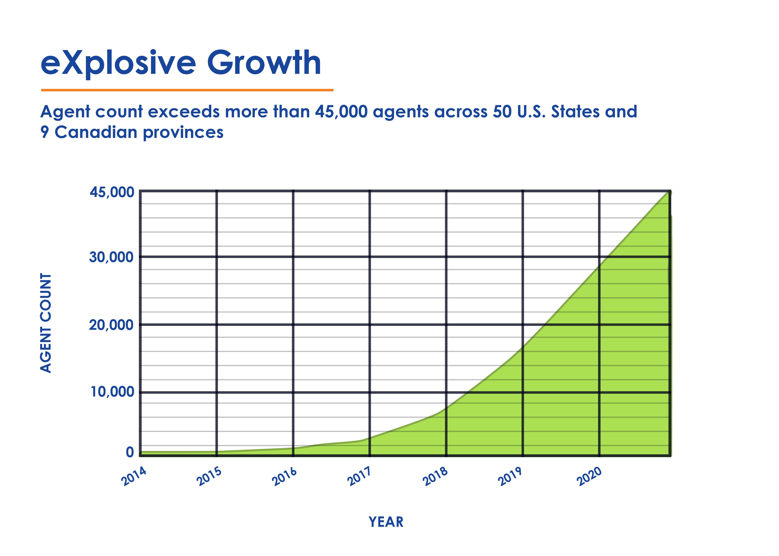
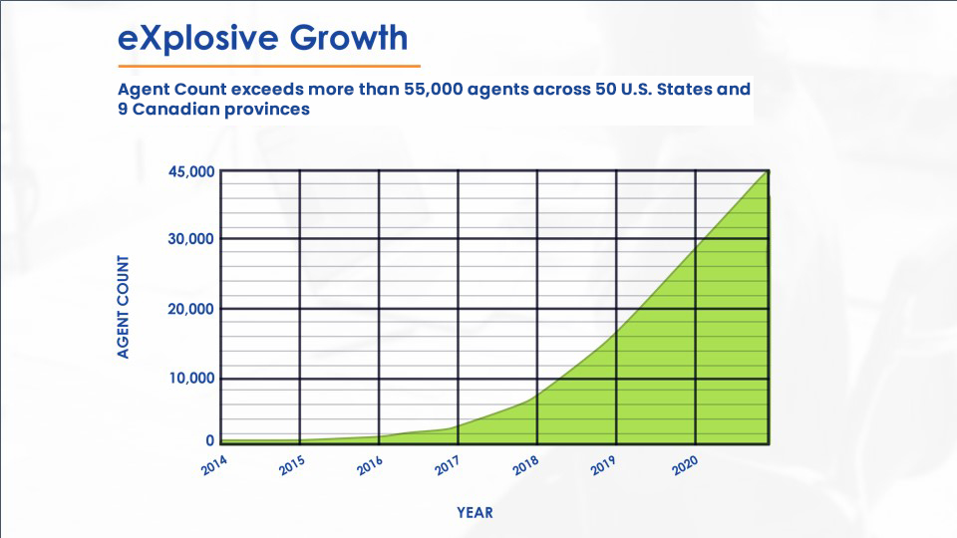
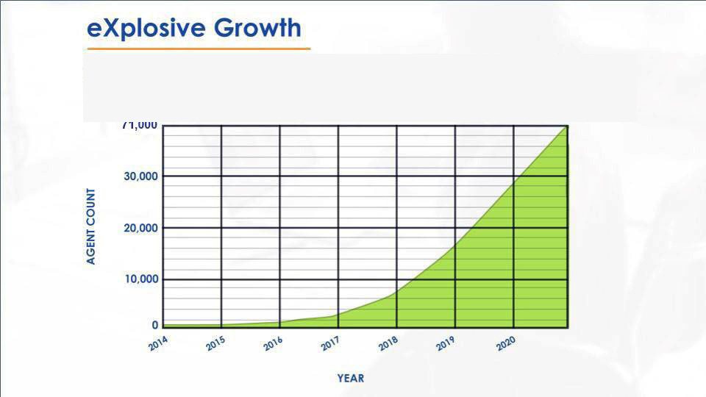
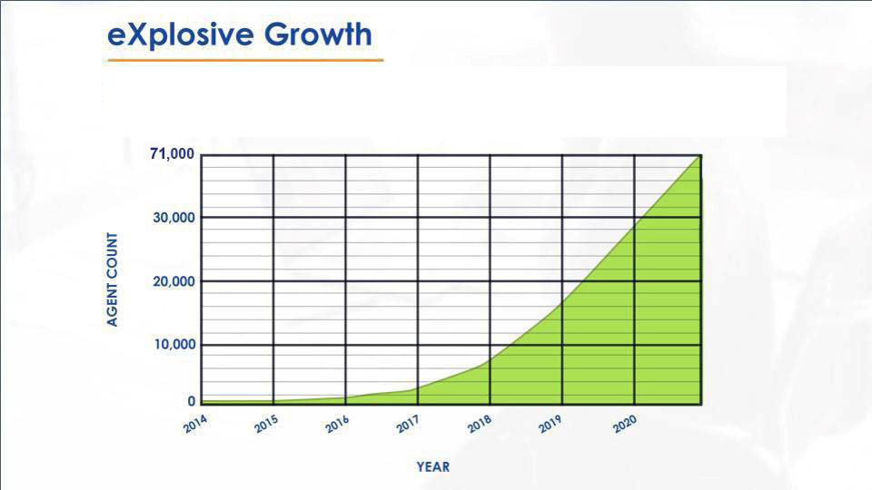
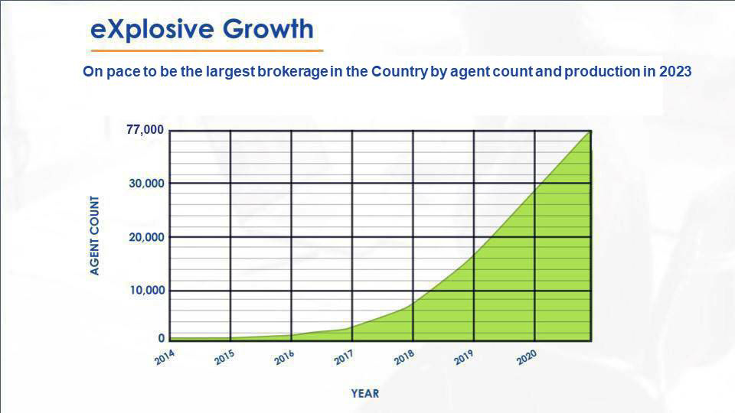
On pace to be the largest brokerage in the Country by agent count and production in 2023

Slide 4
Founder and CEO
Glenn Sanford had important roles at Internet start-ups before launching a real estate career in 2002.
In his fourth year in real estate with a major national franchisor, his team closed more than $60 million in real estate by connecting with consumers online.
Glenn believed that agents and brokers do the heavy lifting in real estate and deserve benefits of being a shareholder and income based on the level of their contribution.
In 2009, Glenn founded the first cloud-based brokerage — eXp Realty.

Slide 5
“The Amazon of Real Estate” ~ Forbes
Old Fashioned real estate brokerages

Slide 6
OLD MODEL
International Company
BROKER DRIVEN

Slide 7
OLD MODEL
International Company
Regional Franchise
BROKER DRIVEN

Slide 8
OLD MODEL
International Company
Regional Franchise
Local Franchise
BROKER DRIVEN

Slide 9
OLD MODEL
International Company
Regional Franchise
Local Franchise
TL/Manager/Recruiter
BROKER DRIVEN

Slide 10
OLD MODEL
International Company
Regional Franchise
Local Franchise
TL/Manager/Recruiter
Office Space/Utilities/Maint.
BROKER DRIVEN

Slide 11
OLD MODEL
International Company
Regional Franchise
Local Franchise
TL/Manager/Recruiter
Office Space/Utilities/Maint.
Agent
BROKER DRIVEN

Slide 12
OLD MODEL
NEW MODEL
International Company
Regional Franchise
NOT A Franchise
Local Franchise
TL/Manager/Recruiter
Office Space/Utilities/Maint.
Agent
BROKER DRIVEN
AGENT DRIVEN

Slide 13
OLD MODEL
NEW MODEL
International Company
Regional Franchise
One Agent-Owned Brokerage
Local Franchise
TL/Manager/Recruiter
Office Space/Utilities/Maint.
Agent
BROKER DRIVEN
AGENT DRIVEN

Slide 14
OLD MODEL
NEW MODEL
International Company
Regional Franchise
Local Franchise
Agents
TL/Manager/Recruiter
Company Support
Office Space/Utilities/Maint.
Agents Receive 50% of eXp Revenue
Agent
BROKER DRIVEN
AGENT DRIVEN

Slide 15
One Brokerage, Not a Franchise
eXp Realty is one international company changing the industry
Typical Franchise
Costly Overhead
Franchise and Desk Fees
Locally Confined
Smaller Referral Network
Inconsistent Growth Incentives
Minimal Opportunities for Ownership
Limited Technology & Support
Few Tools and Support Resources
Cloud Campus Environment
No Desk Fees and Work From Anywhere
Live Training
50+ Hours Weekly Online Training
Real-time Support
Specialized Support Teams Ready to Help
International Collaboration
Expansive Referral Networks and Education
Powerful Equity Opportunities
Revenue Share and Stock Equity Programs

Slide 16
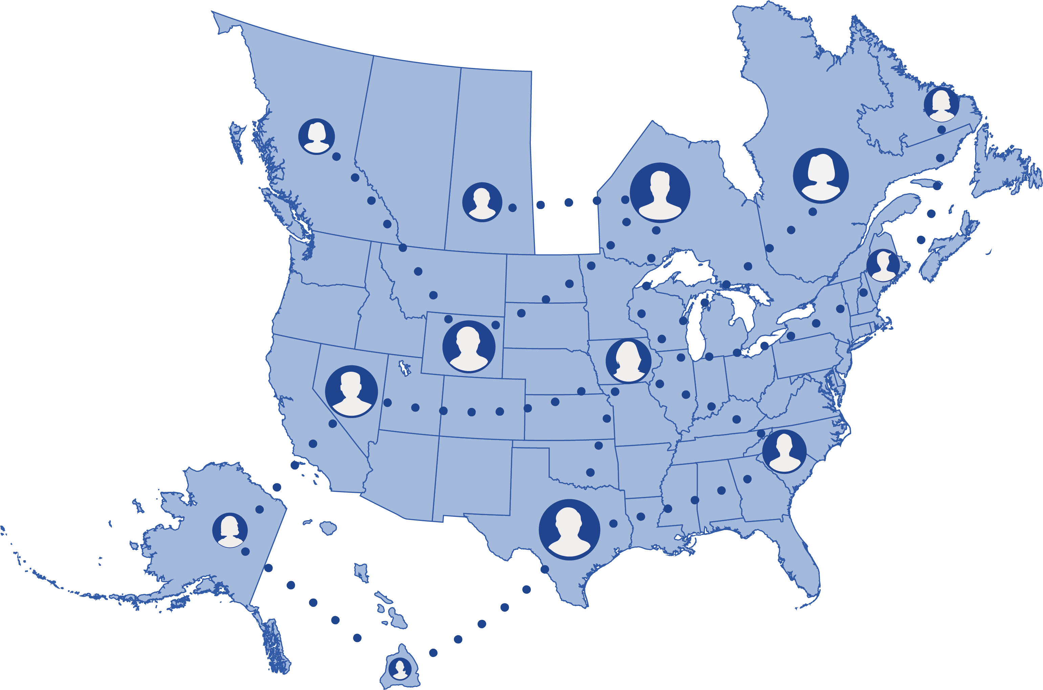
International Collaboration
Interact and learn from other top professionals in the company
Build teams across states and provinces with one nationwide cap
Host and participate in daily, live online gatherings
Benefit from a powerful referral network
Share best practices among peers
Our Business Model
Cloud Campus | Live Training | Real-Time Support | International Collaboration | Equity Opportunities

Slide 18
6 Major Disruptors
How we help agents sell a lot more homes
Industry Leading Technology & Lead Generation
Affordable Health Care
Ownership
Unparalleled Revenue Share
Exit Strategy for Agents

Slide 21
NOT eXp or YOU...
it's eXp AND YOU and your "Business Partners"
that make it powerful

Slide 23
Grow Through Leverage
Without ever paying a piece of your commission, paying a fee, or paying for the systems and staff already built in
Onboarding Concierge
Graphics Designer
Marketing / CRM Expert
Seller Data
CoFounders Training HUB
Coaching & Business Planning
Lead Generation
Production Bootcamps
Agent Attraction System
Next Generation Sales Training

Slide 24
Next Generation Sales Training
This is Your Sales Gym
How to create a listing per week
How to dominate your market
Condition your sales ability to separate yourself
Art of the conversation
Closing skills
Real Results

Slide 25
Lead Generation
KV Core Technology
ISA’s
Online Funnel

Slide 26
6 Major Disruptors
How we help agents sell a lot more homes
Industry Leading Technology & Lead Generation
Affordable Health Care
Ownership
Unparalleled Revenue Share
Exit Strategy for Agents

Slide 27
eXp Agent Healthcare
At eXp Realty, we’re proud to offer eXp Agent Healthcare, which provides U.S. eXp Realty agents with innovative and low-cost healthcare choices.
Insurance and medical cost sharing
Telemedicine services
Supplemental insurance
eXp Agent Healthcare helps agents save money, improve their provider network and decrease their out-of-pocket costs. Find the right plan for you and your family at eXpAgentHealthcare.com.

Slide 28
Equity Opportunities
Agents can become shareholders at eXp Realty
NASDAQ: EXPI
Earn shares on your first transaction
Earn shares when you fully cap
Earn shares when an agent you sponsor closes their first transaction
Sustainable Equity Plan
Up to $16,000 in stock upon the achievement of certain production and cultural goals within your anniversary year
ICON Agent
Award
Agent Equity
Program
Enroll to be paid 5% of every transaction
commission with stock at a 10% discount
Our Business Model
Cloud Campus | Live Training | Real-Time Support | International Collaboration | Equity Opportunities

Slide 29
ICON AGENT
Here’s the scoop!
A 25-30 unit producing agent would have been an ICON agent from 2018 to present.
Below is an illustration of what that Agent's life would have looked like under our model, where they would have received the $16k cap back as a gift.
2018
$16,000 cap would have been granted to Agent at stock price of $7.35 on July 2018 resulting in 2176 shares. When our stock split, these shares doubled in quantity, so this means 4353 shares of stock.
2019
$16,000 cap would have been granted to Agent at $5.21 on July 2019 resulting in 3071 shares. When our stock split, these shares doubled in quantity, so this means 6142 shares of stock.
2020
$16,000 cap would have been granted to Agent at $10.75 on July 2020 resulting in 1488 shares. When our stock split, these shares doubled in quantity, so this means 2976 shares of stock.

Slide 30
2021
$16,000 cap would have been granted to Agent at $36 on July 2021 resulting in 444 shares. Since our stock split prior to these shares, it's a true 444 shares gained (no doubling needed anymore). $16,000 of granted stock.
Recap for 4 years for just doing what you do anyway - selling homes. Absolutely nothing more:
2018: 4353 shares
2019: 6142 shares
2020: 2976 shares
2021: 444 shares
Total value: $476,737
(13,915 shares @ $34.26 a share)

Slide 32
Revenue Share Plan
eXp Realty pays out 50% of company dollar to the agents who help build.
Our Business Model
Cloud Campus | Live Training | Real-Time Support | International Collaboration | Equity Opportunities

Slide 33
Revenue Share Plan Chart
Tiers | eXponential Share % of AGCI | Personal Qualifying Agent Count Needed | Personal Qualifying Agent Requirement
Tier 1 | 3.5% | 1+ | FLA
Tier 2 | 4% | 5+ | FLQA
Tier 3 | 2.5% | 10+ | FLQA
Tier 4 | 1.5% | 15+ | FLQA
Tier 5 | 1% | 20+ | FLQA
Tier 6 | 2.5% | 25+ | FLQA
Tier 7 | 5% | 40+ | FLQA
Our Business Model
Cloud Campus | Live Training | Real-Time Support | International Collaboration | Equity Opportunities

Slide 34
$900,000 | 4% | $3,000 | $36,000

Slide 35
$900,000 | 4% | $3,000 | $36,000
Save After Taxes | Financial Advisor | Monthly Income | Yearly Income

Slide 36
RESIDUAL INCOME!
CAN YOU AFFORD NOT TO HAVE IT?
If Your Monthly Residual Income is… | …It’s Just Like Having This in a fund Earning 4% Interest!
$100 | $30,000
$200 | $60,000
$300 | $90,000
$500 | $150,000
$1,000 | $300,000
$5,000 | $1,500,000
$10,000 | $3,000,000
$20,000 | $6,000,000
$30,000 | $9,000,000
$50,000 | $12,000,000
$100,000 | $24,000,000

Slide 37
OLD MODEL
NEW MODEL
International Company
Regional Franchise
Agents
Local Franchise
Company Support
TL/Manager/Recruiter
Agents Receive 50%
of eXp Revenue
Office Space/Utilities/Maint
Agent
BROKER DRIVEN
AGENT DRIVEN

Slide 38
Attract 6 CAPPING agents
1st | 6 x | $2,800 = | $16,800
YOU
$16,800/Yr
Completely Pays your CAP!

Slide 39
6 x 1 Plan
Attract 6 CAPPING agents who each get 1
1st | 6 x | $2,800 = | $16,800
2nd | 6 x | $3,200 = | $19,200
 |  | $3,000/mo | $36,000
YOU

Slide 40
$900,000 | 4% | $3,000 | $36,000
Save After Taxes | Financial Advisor | Monthly Income | Yearly Income
1st | 6 x | $2,800 = | $16,800
2nd | 6 x | $3,200 = | $19,200
 |  | 4 $3,000/mo | $36,000
YOU

Slide 41
10 x 10 Plan
Attract 10 CAPPING agents who each get 10
1st | 10 x | $2,800 = | $28,000
2nd | 100 x | $3,200 = | $320,000
 |  | $29,000/mo | $348,000
YOU

Slide 42
$8,700,000 | 4% | $29,000 | $348,000
Save After Taxes | Financial Advisor | Monthly Income | Yearly Income
1st | 10 x | $2,800 = | $28,000
2nd | 100 x | $3,200 = | $320,000
 |  | $29,000/mo | $348,000
YOU

Slide 43
10 x 10 Plan
(half cap)
BUT WHAT IF THEY DON’T ALL CAP?
1st | 10 x | $1,400 = | $14,000
2nd | 100 x | $1,600 = | $160,000
 |  | $14,500/mo | $174,000
YOU

Slide 44
$4,350,000 | 4% | $14,500 | $174,000
Save After Taxes | Financial Advisor | Monthly Income | Yearly Income
1st | 10 x | $1,400 = | $14,000
2nd | 100 x | $1,600 = | $160,000
 |  | $14,500/mo | $174,000
YOU

Slide 45
Give a man a fish =
feed him for a day
Teach a man to fish =
feed him for a lifetime

Slide 46
Teach a man to teach a man to fish =
FEED GENERATIONS

Slide 53
Decide to Break the patterns in your life that are no longer serving you .... like building someone else's asset

Slide 54
Become a
Shareholder
Talk to your sponsor, or apply
Today at join.exprealty.com
Check Out www.cofoundersgroup.com

