Slide 1
How to Build Cascading Revenue Share
Maximum Potential Annual
Revenue Share Per Capping Agent
Personal Qualifying
Agent Count Needed
Tier 1
Up to $1,400+ ($4,000 Yr 1)
0
Tier 2
Up to $1,600+
0
Tier 3
Up to $1,000+
0
Tier 4
Up to $600+
5+
Tier 5
Up to $400+
10+
Tier 6
Up to $1,000+
15+
Tier 7
Up to $2,000+
30+

Slide 2
5 Year Example
10 Agents Who Sponsor 10
Tier 1
10 x Up to $4,000
= $40,000 Yr 1 / $14,000 Yr 2 forward
Tier 2
10 x Up to $1,600
= $160,000 Yr
Tier 3
Tier 4
Up to $200,000 yr.
Tier 5
With 110 Agents who cap
Plus shares of EXPI stock
Tier 6
Tier 7

Slide 3
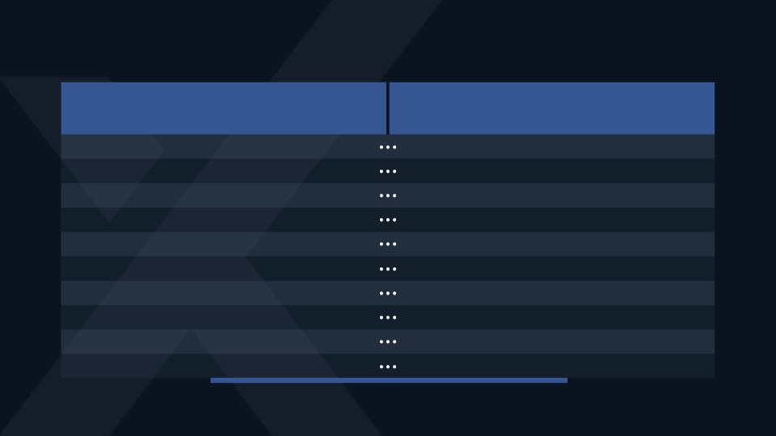
THE POWER OF REVENUE SHARE
If your MONTHLY revenue
share is…
It’s like having this in the bank earning 5% interest…
$1,000
$240,000
$2,000
$480,000
$5,000
$1,200,000
$10,000
$2,400,000
$20,000
$4,800,000
$30,000
$7,200,000
$50,000
$12,000,000
$100,000
$24,000,000
$200,000
$48,000,000
$422,977.69
$101,490,000
What’s your FREEDOM STRATEGY?

Slide 4
AGENT COUNT
ANNUAL
MONTHLY
50
$40,600
$3,383/month
100
$81,200
$6766.66/month
250
$203,000
$16,916/month
500
$406,000
$33,833/month
1000
$812,000
$67,666/month
2000
$1,624,000
$135,333/month
5000
$4,060,000
$338,333/month
Assumes average of $812 annually with 30+ FLQA

Slide 5
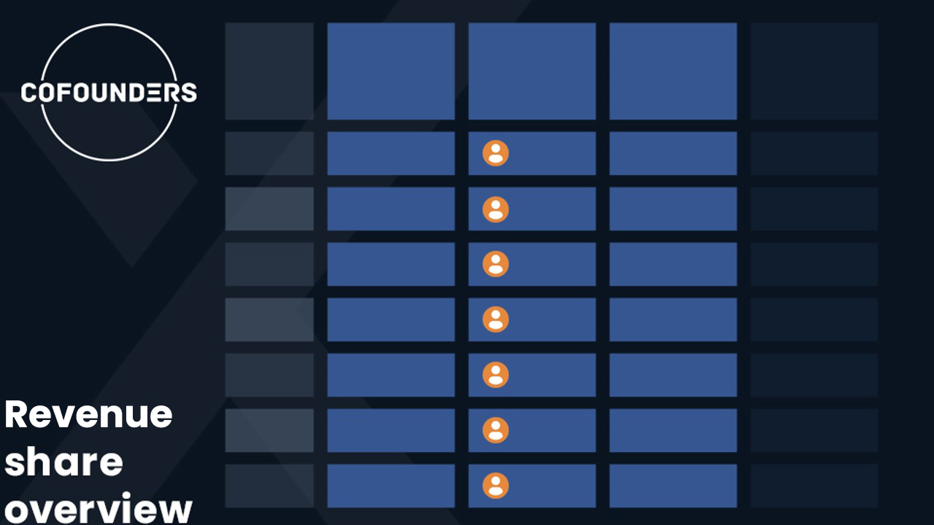
eXpansion
Share
(% of AGCI)
1st Tier
Agents Needed
(FLQRs)
Top % of Revenue
Share Pool
Max Potential
Per Agent
(per year)
$1,400+
($4,000 Yr 1)
TIER 1
0
17.5%
TIER 2
0.2%
0
20.0%
$1,600+
TIER 3
0.1%
0
12.5%
$1,000+
TIER 4
0.1%
5 +
7.5%
$600+
TIER 5
0.1%
10 +
5.0%
$400+
TIER 6
0.5%
15 +
12.5%
$1,000+
TIER 7
0.5%
30 +
25.0%
$2,000+

